Slide 1
SEISMIC HAZARD ASSESSMENT SYSTEM
TSP- AI ML Fundamentals (Capstone Project)
Presented By:
Student Name -- DHIVYA E
NM ID -- au510321214002
College Name -- Arulmigu Meenakshi Amman College of Engineering
Guided By:
Ramar Bose
Sr.AI Master Trainer

Slide 2
OUTLINE
Abstract
Problem statement
Proposed System/Solution
Algorithm & Deployment
Project Demo(photos / videos)
Conclusion
Future Scope
References
GitHub Link

Slide 3
ABSTRACT
Earthquakes are natural disasters that can cause significant damage and loss of life. Accurate prediction of earthquakes is essential for developing early warning systems, disaster planning, risk assessment, and scientific research. This project aims to predict the magnitude and probability of Earthquake occurring in a particular region (California, United States) from the historic data of that region using various Machine learning model.

Slide 4
Problem Statement
Earthquakes are one amongst the foremost destructive natural disasters.
They typically occur without notice and do not allow much time for people to react.
Earthquake can cause serious injuries and loss of life and destroy numerous buildings and infrastructure, leading to great economy loss.
Machine learning is a subfield of Artificial Intelligence, which is broadly defined as the capability of machine to imitate the intelligent human behavior.

Slide 5
Proposed Solution
As earthquake is a calamitous occurrence that is detrimental to human interest and has an undesirable impact on the environment.
Earthquake prediction is branch of seismology concerned with the specification of the time, location and magnitude of future earthquakes.
The prediction of earthquakes is clearly critical to the protection of our society, where we discover this as a motivating problem to be solved.

Slide 6
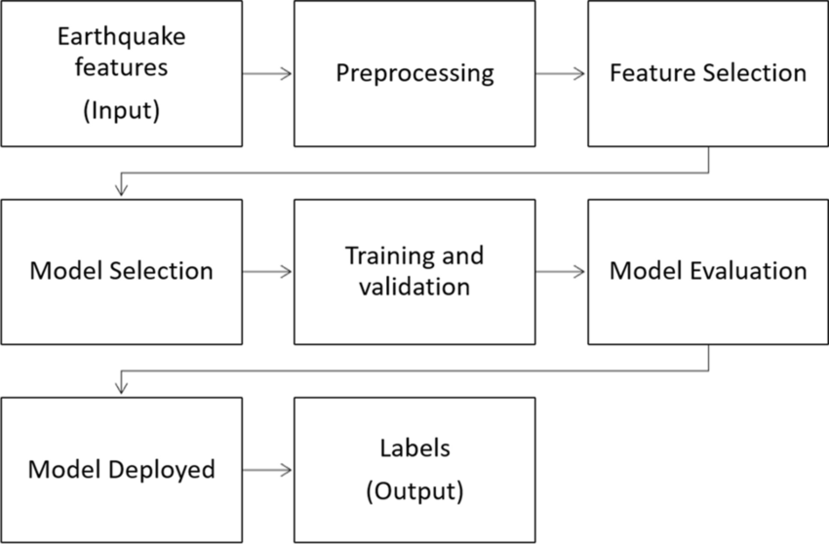
Algorithm & Deployment
System Deployment Approach

Slide 7
Model Development Algorithm
1. Import necessary libraries
2. Load the downloaded data from a panda data frame
3. Explore the data to understand its structure and identify potential issues
4. Divide the data into training and testing sets for model training and evaluation:
5. Create and train the model
6. Evaluate the model's performance on the testing data using metrics like:
Mean Squared Error (MSE)
R-squared (coefficient of determination)
7. Use the trained model to predict earthquake magnitudes for new, unseen data

Slide 8

Project Demo(Recorded Video)

Slide 9
Conclusion
The analytical process started from data cleaning and processing, missing value, exploratory analysis and finally model building and evaluation.
The best accuracy on public test set is higher accuracy score is will be find out.
This application can help to find the Prediction of Earth Quake.

Slide 10
Future Scope
Earth Quake prediction to connect with AI model.
To automate this process by show the prediction result in web
application or desktop application.
To optimize the work to implement in AI environment.

Slide 11
References
Project Github link, DHIVYA E, 2024.
Project vedio recorded link (you tube/github), DHIVYA E, 2024.
Project ppt and Report github link,DHIVYA E, 2024.

Slide 12
GitHub Link
https://github.com/dhivya20-04/nm-project-earthquake-prediction

Slide 13
THANK YOU

